Slide 1
PREDICTION OF STOCKS
Presented by
D.SHIVANI
K.SAI ANUHYA
K.SAI DEEKSHITH REDDY
M.SRAVANI
17R01A0575
17R01A0592
17R01A0593
17R01A05A2
Under the Guidance of:
Mrs. B.Vasavi
(Assistant Professor)

Slide 2
CONTENTS
Abstract
Introduction
Existing System Drawbacks
Proposed System Advantages
Project Requirements
Implementation Diagram
Data Flow Diagram
Use Case Diagram
Architecture
Modules
Algorithms
Pseudo Code steps
Output
Accuracy
Conclusion
Future Scope
References

Slide 3
Abstract:
The aim of the mini project is to analyze the different machine learning forecast techniques to predict the stock to invest in the future for better returns based on past returns and various other metrics of the company.
We are going to produce a portfolio of multiple stocks in order to minimize the risk factor. We do this by the application of supervised learning algorithm and classification methods of Machine Learning.
The motivation is to provide an investor an insight on which stocks to invest in based on its previous returns and the company's previous price movement

Slide 4
The volatility and violent nature of the stocks makes it difficult to predict when to invest and as the data keeps on increasing it makes it nearly impossible for a person to come to a decision without any help.
So, we provide a machine learning aided approach to evaluate few different stocks using diverse attributes present in the data and to provide an analysis on which ones are better to invest in.

Slide 5
Introduction:
The sector that we chose to implement these machine learning algorithms is stock market.
The idea is to indent a Long-Short Term Memory (LSTM) network to calculate the actual output and the hypothesis output) predicted by the model and to provide information on stock prices to investors and traders.
Investment firms, hedge funds and even individuals are using financial models to better understand and interpret market patterns and make investments and trade for better profit.

Slide 6
Sometimes external factors like trends, inflation, liquidity, etc and there are various machine learning concepts and algorithms to do so.
In this project we are going utilize the concept of Neural Networks in Machine Learning to build algorithm to predict stock prices.

Slide 7
Problem Definition:
The challenge of this project is to accurately predict the future closing value of a given stock across a period of time in the future using predictive models.
Now with libraries like tensor flow one can build powerful predictive models trained on massive of dataset.

Slide 8
Project Objective:
For this project we will be using a Long Short Term Memory networks - usually just called "LSTM“, which is an improved model of Recurrent Neural Network, and Linear Regression model to predict the closing the google and other stock prices using a dataset of past prices.
In the end, we are going to compare the of both models to see the improvement and the difference between the two.

Slide 9
Existing System Drawbacks:
Predicting how the stock market will perform is one of the most difficult things to do.
There are so many factors involved in the prediction – physical factors vs. psychological, rational and irrational behaviour, etc.
All these aspects combine to make share prices volatile and very difficult to predict with a high degree of accuracy.

Slide 10
Proposed System Advantages:
It allows the investors or online traders to peek into the reasons behind a certain market trend, pricing and understand price behavior, which was otherwise impossible to know just a few years back.
Access to Machine Learning helps mitigate possible risks in online trading and enables the investor to make precise decisions.

Slide 11
Project Requirements:
Programming Languages:
Python
Java
Libraries needed: Numpy,Scipy,Matplotlib,Tensorflow,Keras,
Pandas, Sklearn
Software:
Anaconda Distribution
Anaconda Navigator
Conda

Slide 12
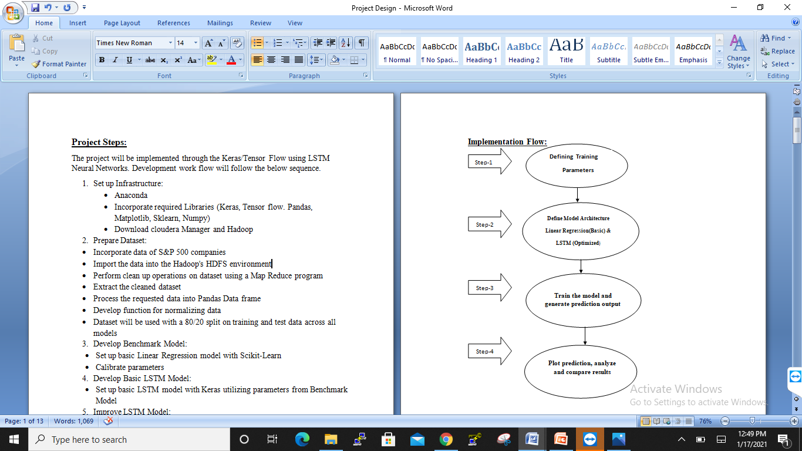
Implementation Diagram:

Slide 13
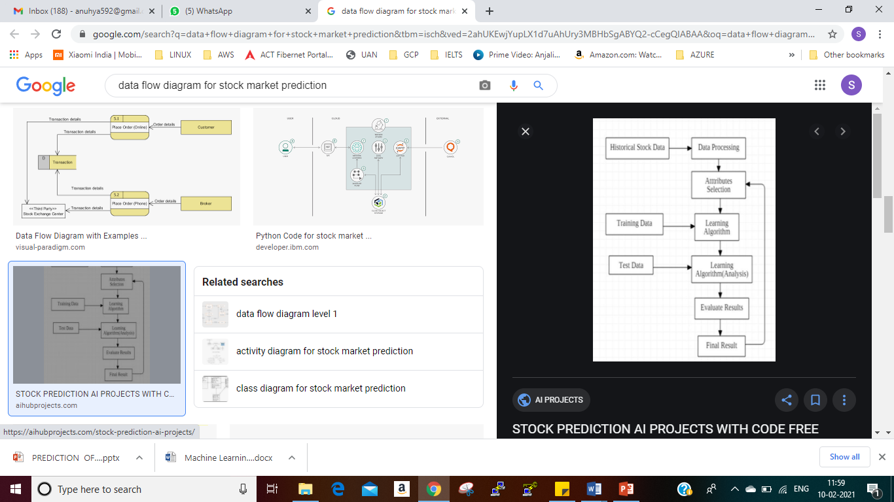
Data Flow Diagram:

Slide 14
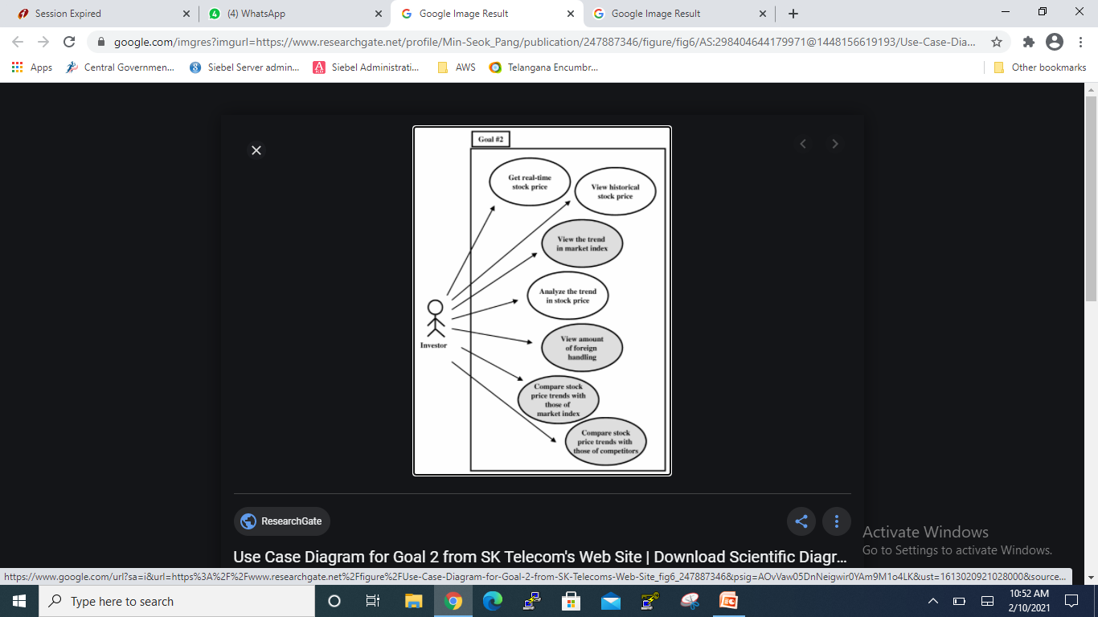
Use Case Diagram:

Slide 15
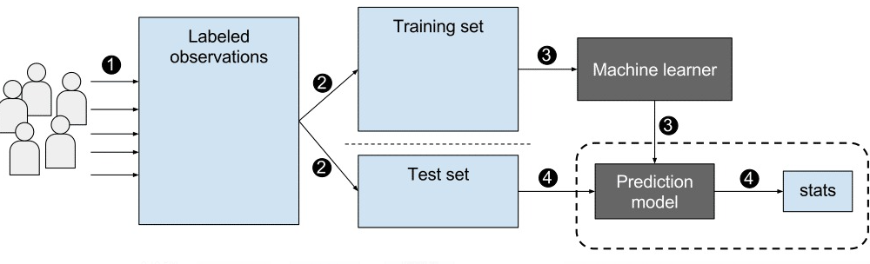
Architecture:

Slide 16
Modules:
Download and view Dataset
Clean the dataset and delete unwanted information
Split dataset into train and test sets
Apply machine learning algorithm
Develop prediction model
Use of statistics for analysis

Slide 17
Algorithm:
Linear Regression:
Linear regression is one of the easiest and most popular Machine Learning algorithms.
It is a statistical method that is used for predictive analysis.
Linear regression makes predictions for continuous/real or numeric variables such as sales, salary, age, product price, etc.
Linear regression algorithm shows a linear relationship between a dependent (y) and one or more independent (y) variables, hence called as linear regression.

Slide 18
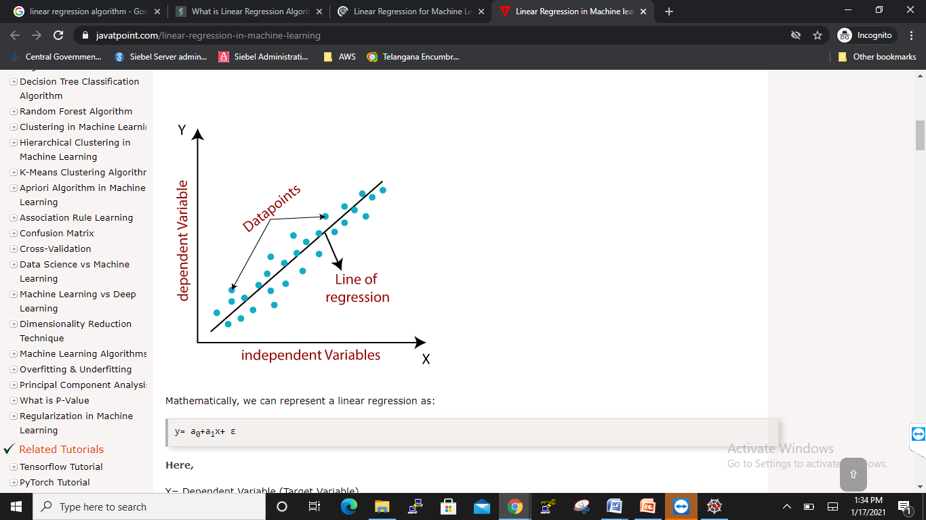

Slide 19
In addition to adjusting the architecture of the Neural Network, the following full set of parameters can he tuned the prediction model:
Input Parameters:
Preprocessing and Normalization
Neural Network Architecture:
Number of Layers
Number of Nodes
Training Parameters:
Training /Test Split (In this project we divided dataset into 75/25 for Linear Regression Model and 80/20 for LSTM)
Batch Size
Optimizer Function
Epochs How many times to in through training process)

Slide 20
Pseudo Code steps:
1. Explore stock prices (dataset)
2. Clean the dataset and preprocess it for the models.
3. Implement basic model of the algorithm using Linear Regression.
4. Implement a LSTM Neural Network
5. Finally compare the output with the dataset.

Slide 21
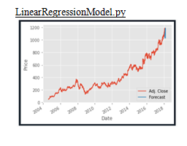
Output:

Slide 22
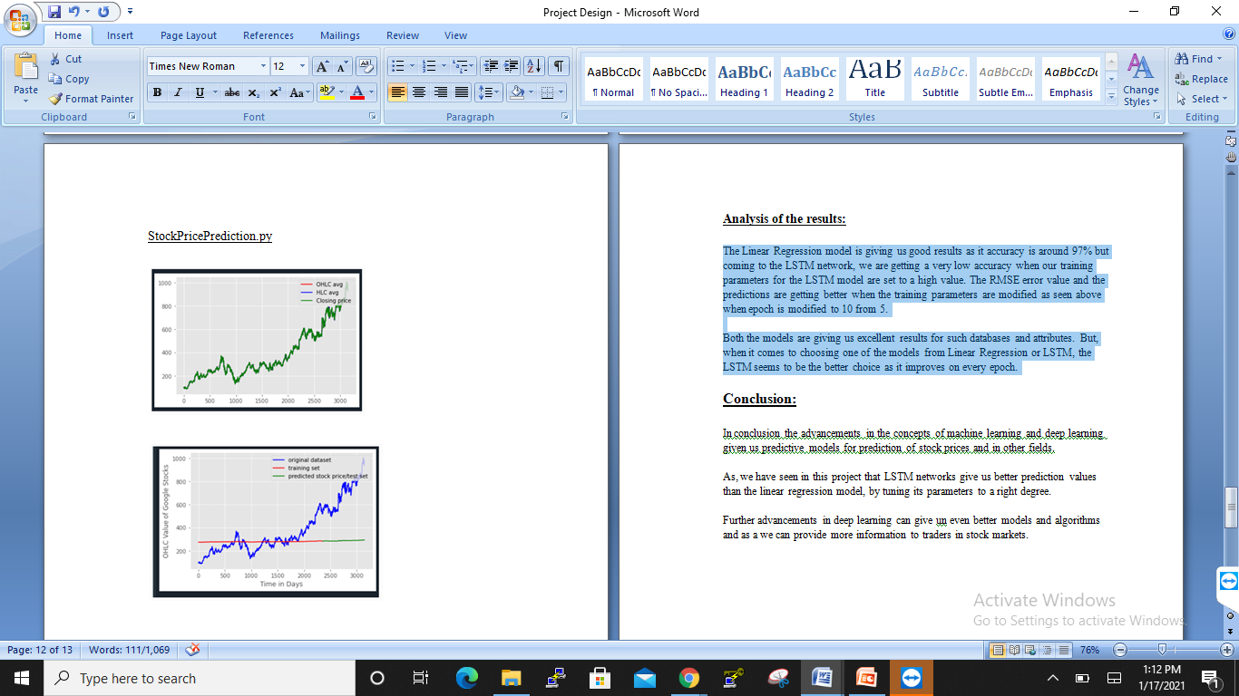

Slide 23
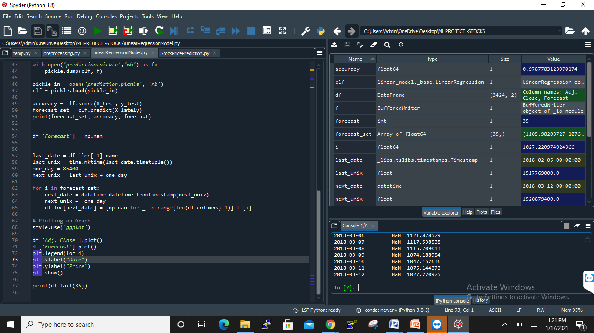
Accuracy:
Linear Regression model gives us prediction for the next month based on the given training set and we have achieved 97.8% for our predictions.

Slide 24
Conclusion:
In conclusion the advancements in the concepts of machine learning and deep learning given us predictive models for prediction of stock prices and in other fields.
As, we have seen in this project that LSTM networks give us better prediction values than the linear regression model, by tuning its parameters to a right degree.
Further advancements in deep learning can give un even better models and algorithms and as a we can provide more information to traders in stock markets.

Slide 25
Future Scope:
The Linear Regression model is giving us good results as it accuracy is around 97% but coming to the LSTM network, we are getting a very low accuracy when our training parameters for the LSTM model are set to a high value. The RMSE error value and the predictions are getting better when the training parameters are modified as seen above when epoch is modified to 10 from 5.
Both the models are giving us excellent results for such databases and attributes. But, when it comes to choosing one of the models from Linear Regression or LSTM, the LSTM seems to be the better choice as it improves on every epoch.

Slide 26
References:
https://en.wikipedia.org/wiki/Stock_market_prediction
https://keras.io/models/sequential/
https://www.tensorflow.org/api_docs/
https://scikit-learn.org/stable/
https://github.com/Rajat-dhyani/Stock-price-predictor
httpsandas.pydata.org/pandas-docs/stable/
https://colab.github.io/posts/2015-08-Understanding-LSTMs/
https://en.wikipedia.org/wiki/Deep_learning

Slide 27
THANK YOU

